Slide 2
US Craft Beers and Breweries Presentation
By Balasubramaniam and Muchigi

Slide 3
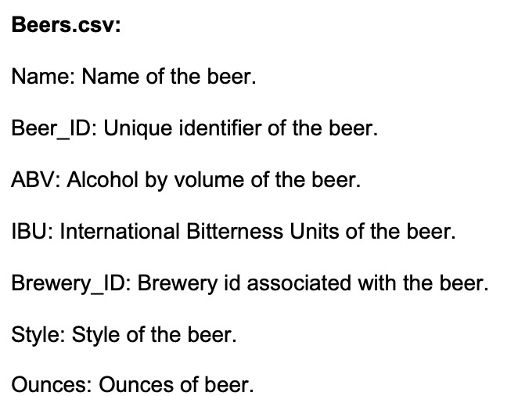
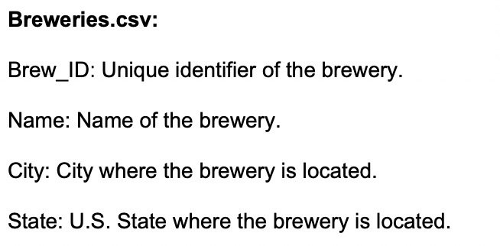
Data Description

Slide 4
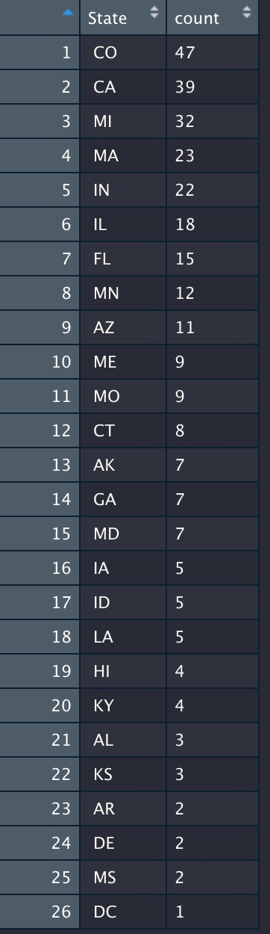
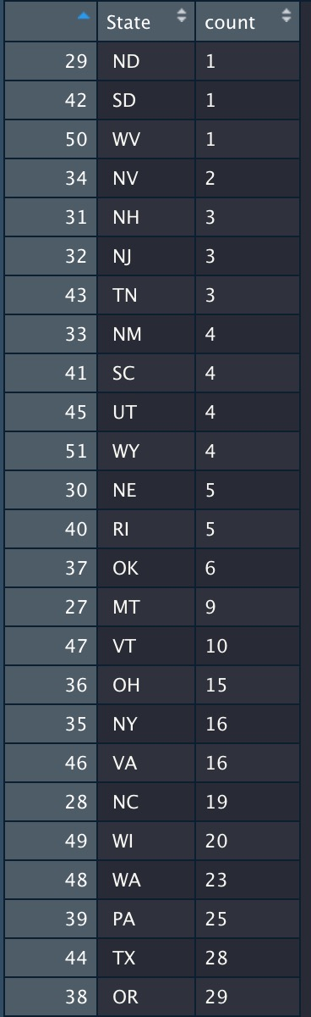
How many breweries are present in each state?

Slide 5
Inference: Top 3 Highest No Breweries in USA
 | No of Breweries | State
1 | 47 | CO- Colorado
2 | 39 | CA- California
3 | 32 | MI- Michigan

Slide 6
Barplot- State Vs Breweries Count

Slide 7
Address the missing values in each column.
ABV | IBU | Style
62 | 1005 | 5

Slide 8
Compute the median alcohol content and international bitterness unit for each state.

Slide 9
Compute the median alcohol content and international bitterness unit for each state. Plot a bar chart to compare ABV per State

Slide 10
Which state has the maximum alcoholic (ABV) beer? Which state has the most bitter (IBU) beer?
ABV | IBU | State
ABV |  | MA-Massachusetts
 | IBU | NJ- New Jersey

Slide 11
Comment on the summary statistics and distribution of the ABV variable.
ABV is normally in the range of 0.001 to 0.128.
But most of the beers in the country have a ABV of 0.059
Based on the histogram and qqplot we can see that the distribution is normally distributed

Slide 12
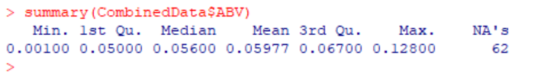
Below is the summary statistic result

Slide 13
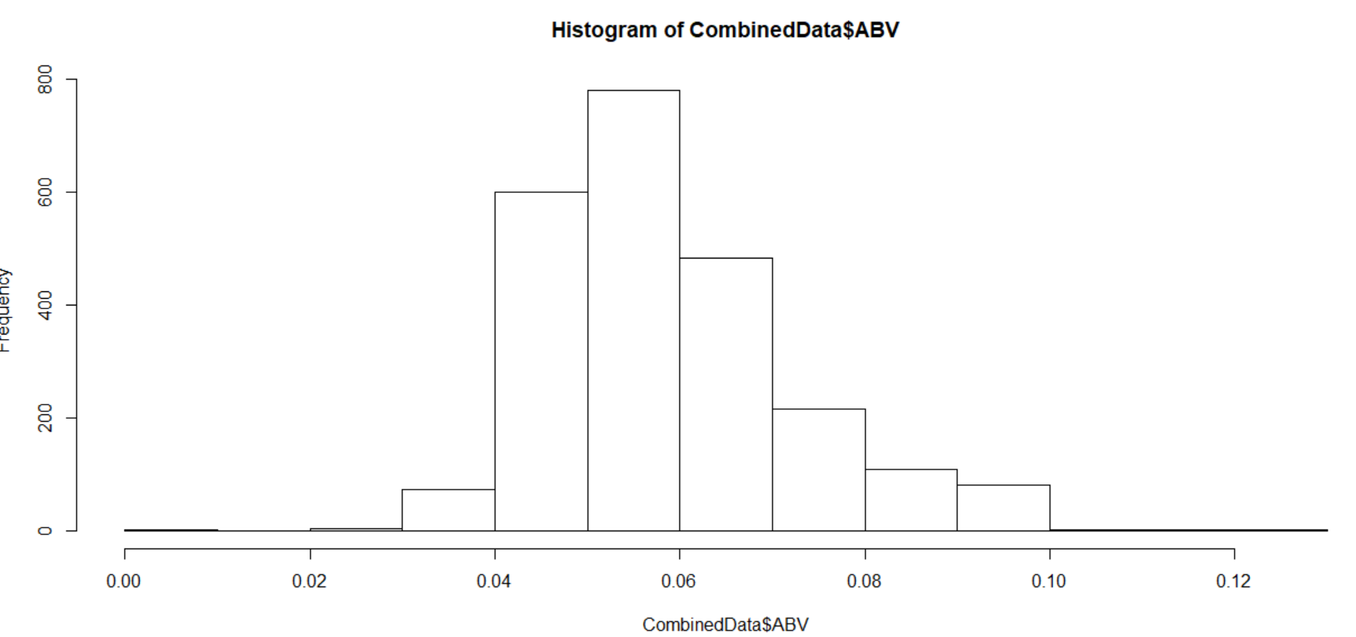
Comment on the summary statistics and distribution of the ABV variable.

Slide 14
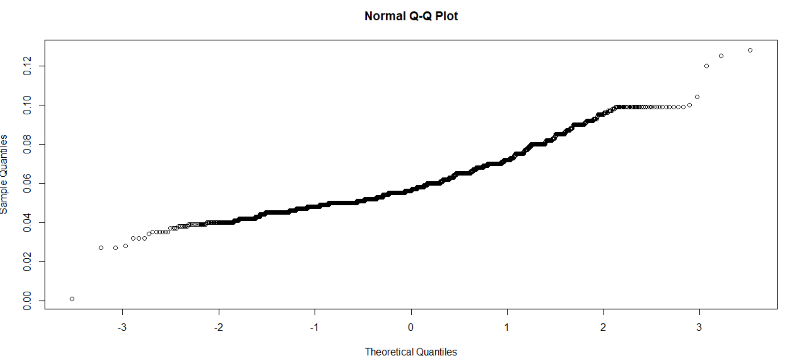
QQ Plot Distribution

Slide 15
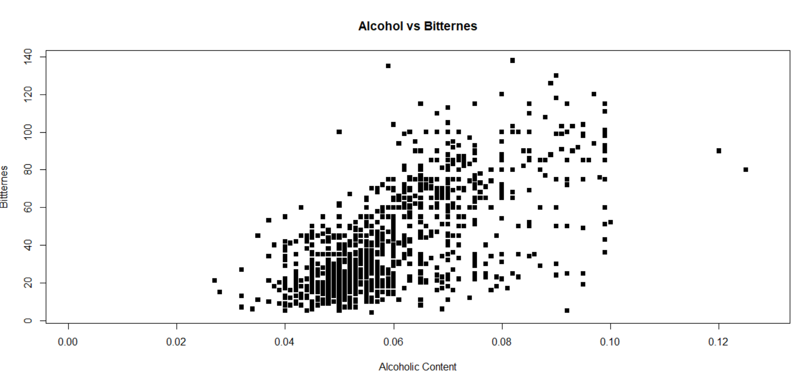
Is there an apparent relationship between the bitterness of the beer and its alcoholic content? After Removing NA Value/Draw a scatter plot.

Slide 16
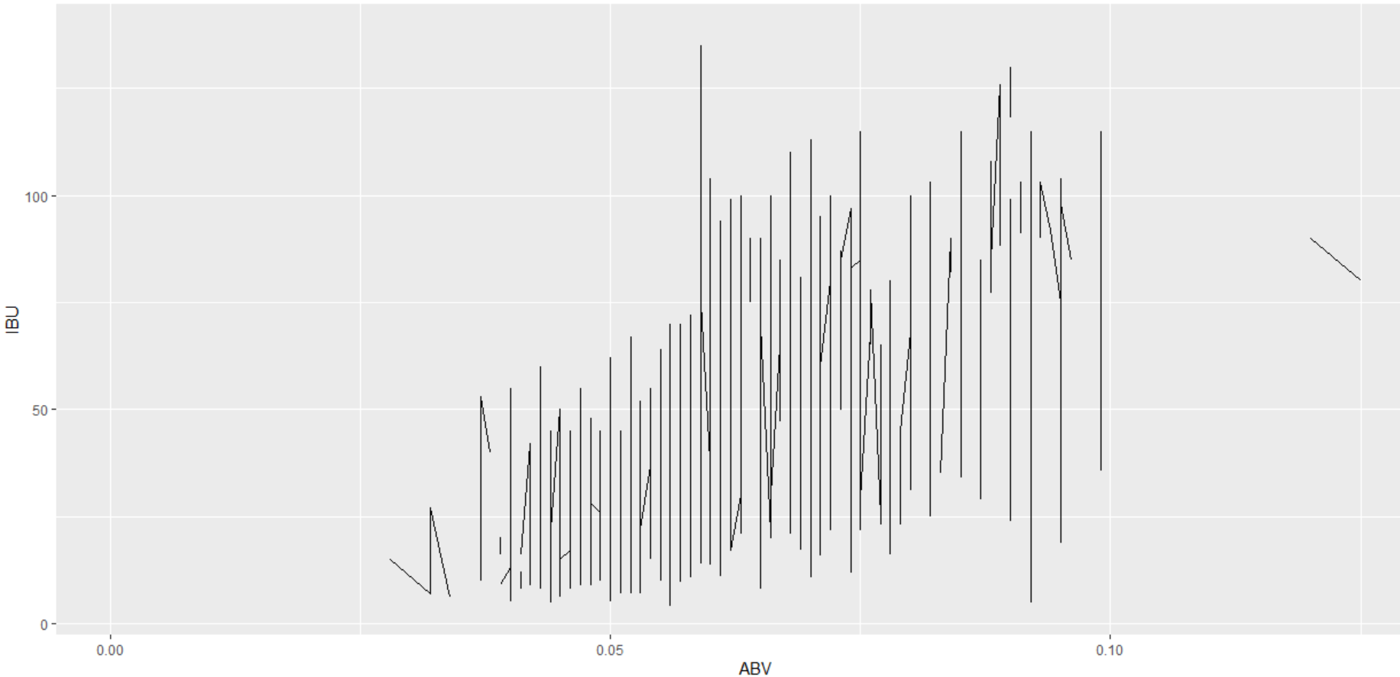
Is there an apparent relationship between the bitterness of the beer and its alcoholic content? Draw a scatter plot.

Slide 17
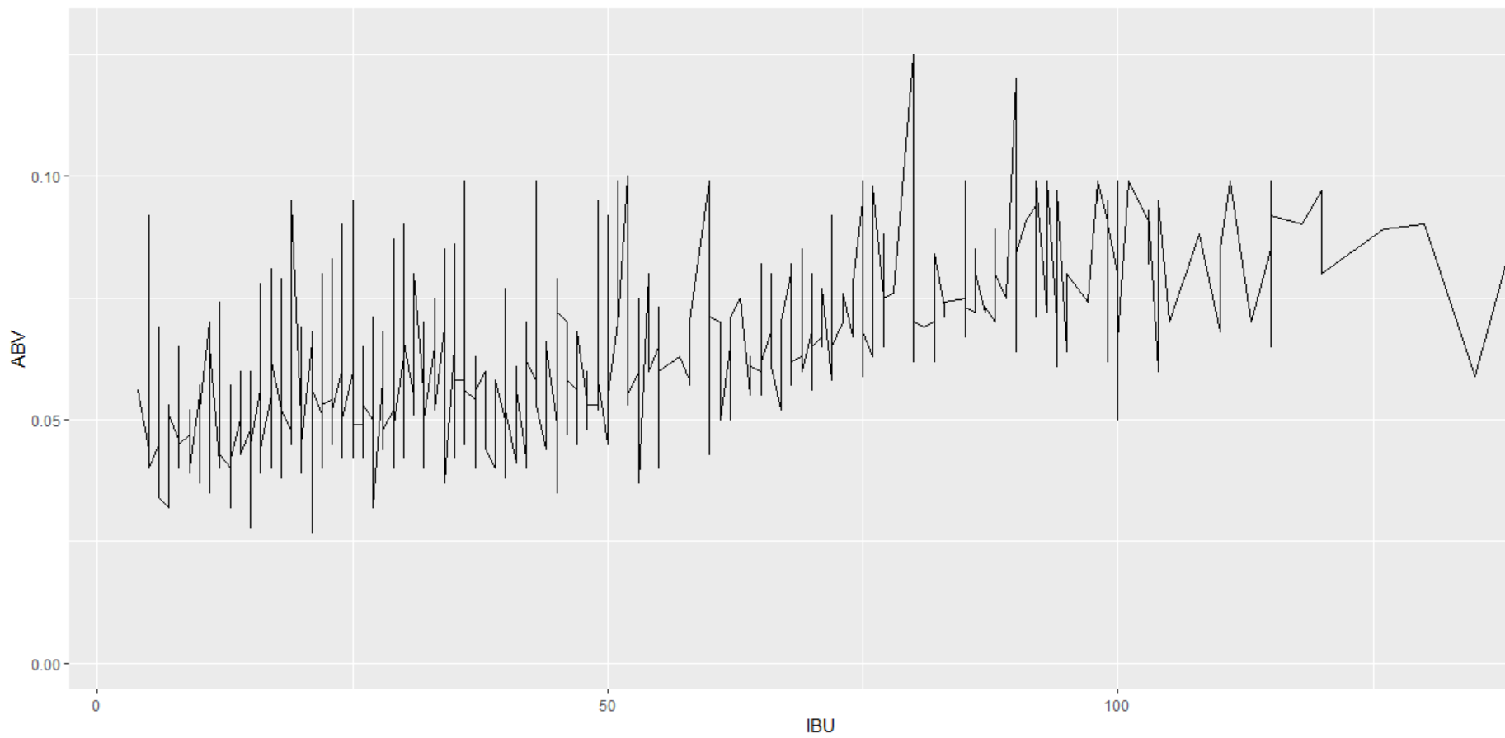
Is there an apparent relationship between the bitterness of the beer and its alcoholic content? Draw a scatter plot.

Slide 18
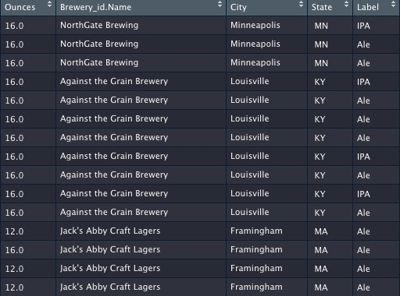
KNN Analysis
We used regular expressions to create Label data

Slide 19
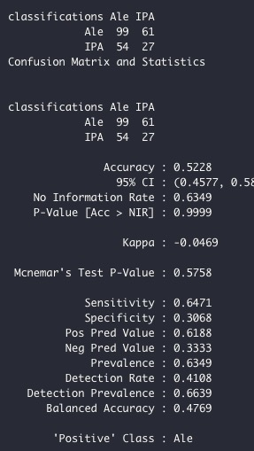
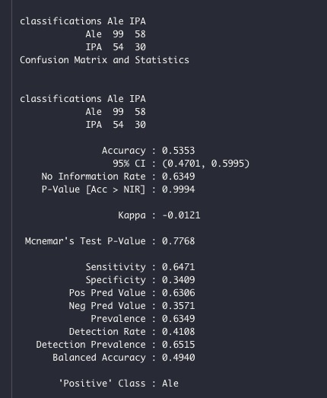
KNN Analysis
We trained the data with .75 split
We then ran the model on K = 3 & 5
Below were our results
The model with K = 3 had 0.52 accuracy and K = 4 had accuracy of .533

Slide 20
KNN Analysis
Were not satisfied with the results, so we plotted chart with the best K to use
And we discovered that 80 is the best

